Slide 1
CPE 133
Function Forms
Function Representations
Experiment 1

Slide 2
Digital Design Description
An approach to digital design:
Define the problem: understand the starting point and requirements
Describe your solution to the problem: propose your path to the solution
Implement your solution to the problem: embodiment of the solution
Main Design approaches:
BFD – brute force design (iterative design)
IMD – iterative modular design
MD – modular design

Slide 3
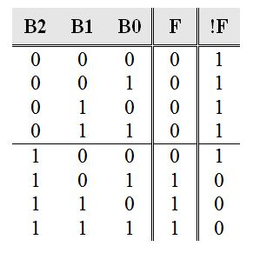
Standard SOP and POS Forms
Function Equation: Standard Sum of Products (SOP)
Standard Product of Sums (POS)
Write equation for !F
DeMorganize multiple times
Tabular Description:
Truth Table

Slide 4
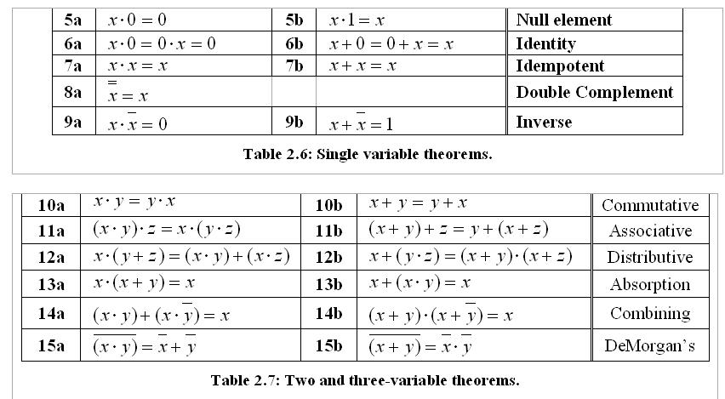
Boolean Algebra Theorems

Slide 5
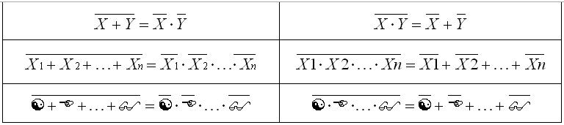
DeMorgan’s Theorem
General form
Most used theorem in digital design

Slide 6
Standard SOP and POS Forms
Function Equation: Standard Sum of Products (SOP)
Standard Product of Sums (POS)
Write equation for !F
DeMorganize multiple times
Tabular Description:
Truth Table

Slide 7
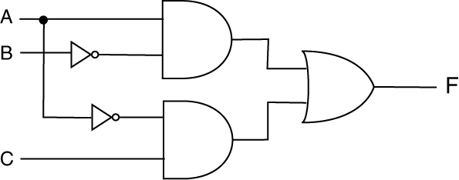
Example: SOP ↔ POS
Change the following circuit implementation from a SOP (AND/OR) to a standard SOP & POS (OR/AND) form.

Slide 8
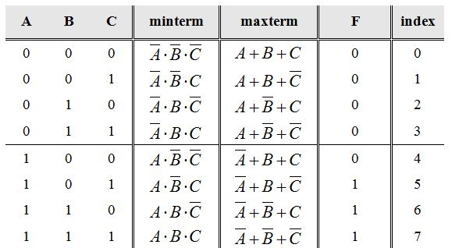


Compact Minterm & Maxterm Forms
Minterm: standard product term
Maxterm: standard sum term
$$minterm=\overline{maxterm}$$
$$maxterm=\overline{minterm}$$

Slide 9
Representing Functions
Standard SOP & POS (equations)
Compact minterm & Compact maxterm
Circuit form (schematic)
Truth table
You should be able to go from any one form to any other form

Slide 10
Experiment 1: The Half Adder (HA)
Half adder: single bit adder
Design half adder; describe circuit using standard SOP form

Slide 11
Quick Verilog Introduction
HDL: Hardware Description Language
Verilog: one type of HDL
Uses: models digital circuits and systems
model: a description of something that presents a particular level of detail
digital system: any digital circuit that processes or stores information

Slide 12
Why Verilog is Great
presents a formal and unambiguous way to model digital circuits
models allow for the verification of circuits using simulation
different level of models supports the understanding of complex digital systems
models can be used to automatically generate actual circuits

Slide 13
What VHDL Isn’t
VHDL is not a programming language
as the name states, it’s a description language
Bad at and/or dislike programming?
no problem: VHDL is not programming, it’s a hardware description language
You’re not writing VHDL programs or doing software
You’re designing digital circuit models

Slide 14
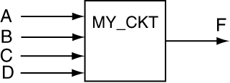
Example
Implement the following function:
module my_ckt (A,B,C,D,F);
input A,B,C,D;
output F;
assign F = (A & ~B) | (C & ~D);
endmodule

Slide 15
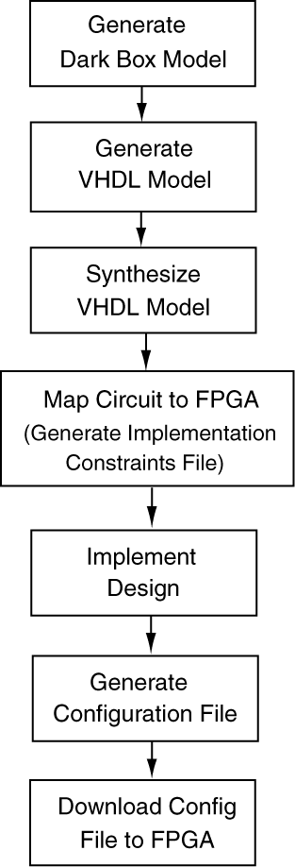
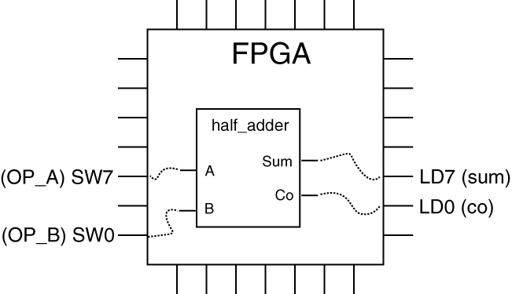
Xilinx Design Methodology
On a piece of paper
Xilinx text editor
Xilinx toolchain tool
Xilinx toolchain tool
Xilinx toolchain tool
Xilinx toolchain tool
Your design needs to be
“mapped” to pins on FPGA
Export software

Slide 16
Lab Activity: Experiment 1
Main idea
Get used to Xilinx Vivado environment
Giant hand-holding exercise
You’ll soon know more than me
Part A) Design and implement a half-adder (HA) on the Basys3 development board
Part B) Design and implement a full-adder (HA) on the Basys3 development board

Slide 17
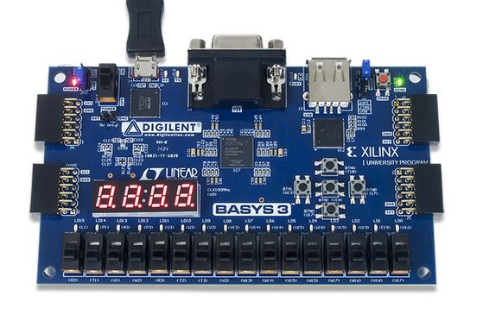
The Basys3 Board
Basys3 Black Box Model

Slide 18
BASYS3

